Slide 1


RideMate
Your Ultimate Riding Companion
Ride Smarter. Share Freely. Connect Globally.
Notes:
1

Slide 2

What is RideMate?
RideMate is a cloud-powered biking companion that unifies expense tracking, ride sharing, and performance analytics. Whether you're a solo rider or part of a riding crew, RideMate transforms how bikers connect with their bikes and each other through real-time data and shared experiences.
Notes:
2

Slide 3

The Problem We Solve
Scattered Tools
No Social Platform
Riders juggle multiple apps to track maintenance, expenses, and ride stats—no unified solution exists.
Sharing ride experiences happens across fragmented social networks with no dedicated biking context.
Missing Insights
Riders lack actionable data about their bikes, spending patterns, and performance metrics in one place.
Notes:
3

Slide 4
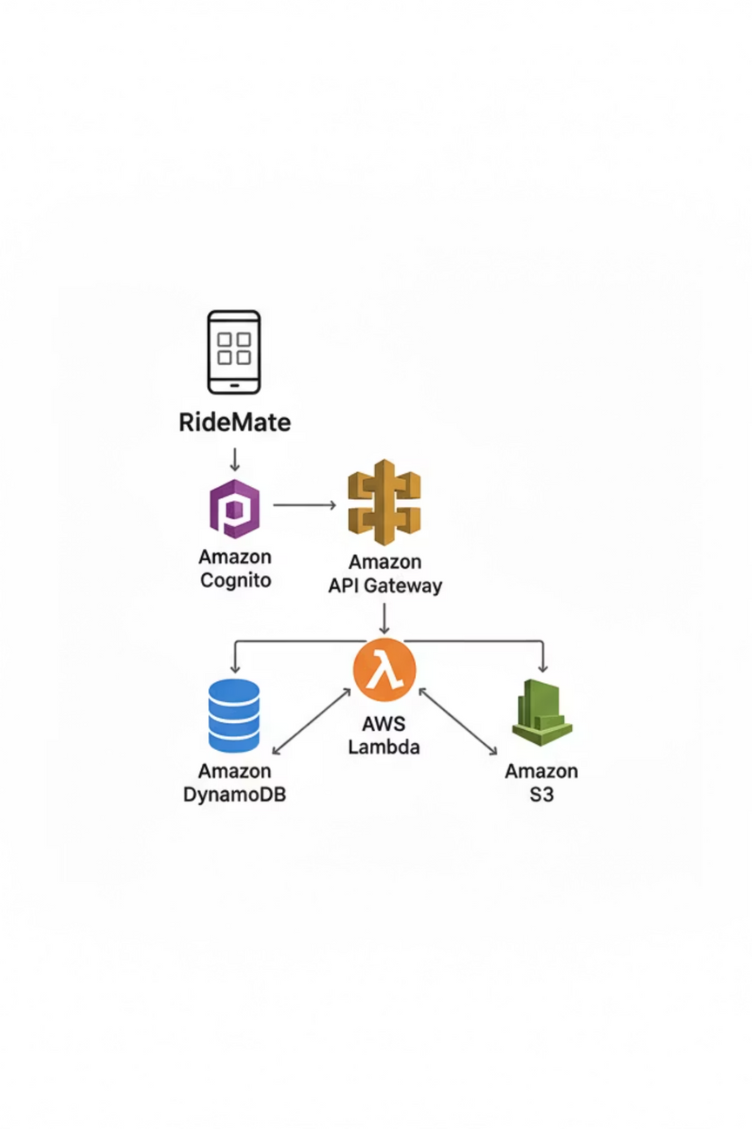




Built on Modern Cloud Architecture
RideMate leverages a serverless, cloud-native AWS stack for reliability, scalability, and security.
AWS Cognito
DynamoDB
Secure authentication & user management
Fast, scalable NoSQL database
Lambda & API Gateway
S3 Bucket
Serverless computing at scale
Secure file and media storage
Frontend: React + Tailwind CSS for a responsive, modern user experience
Notes:
4

Slide 5








Powerful Features for Every Rider
Ride Stats
Expense Tracking
Track distance, speed, routes, and performance metrics with detailed analytics dashboards.
Log fuel, maintenance, repairs, and insurance. Monitor spending patterns over time.
Mobile First
Social Feed
Fully responsive design optimized for riding on the go with intuitive controls.
Share ride photos, experiences, and achievements with the biking community.
Notes:
5

Slide 6

Why RideMate Stands Out
100% Serverless
Zero infrastructure management. Pure AWS serverless architecture scales automatically with demand.
Real-Time & Fast
Sub-second response times. Experience instant data syncing across all your devices.
Bank-Level Security
End-to-end encryption and OAuth 2.0 authentication protect your personal and bike data.
Built by Riders
Designed and developed by people who live and breathe motorcycling. We understand your needs.
Notes:
6

Slide 7


What's Next: Future Roadmap
Live GPS Tracking
Real-time route mapping and turn-by-turn navigation with group ride visibility.
Group Coordination
Plan group rides, coordinate events, and sync schedules with fellow riders.
Smart Reminders
Push notifications for scheduled maintenance, inspections, and ride suggestions.
Wearable Integration
Connect smartwatches and fitness trackers for comprehensive biometric ride data.
Notes:
7

Slide 8

Ride Smarter. Share Freely. Connect Globally.
RideMate transforms solitary journeys into a connected community. With cutting-edge cloud technology and features built specifically for riders, we're redefining what it means to ride in the modern era.
RideMate — Your Ultimate Riding Companion
Powered by serverless AWS architecture. Built for the open road.
Notes:
8

